Slide 1
Angle Controlled rod using Brushless motor
Moustafa Elsayed 201600848
Khaled Osama 201600515

Slide 2
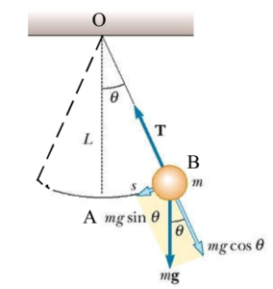

Introduction to the model
Transfer Function (white box modeling)
$$\frac{θ\left(s\right)}{τ(s)}=\frac{\frac{1}{ml^{2}}}{s^{2}+\frac{b}{ml^{2}}s+\frac{g}{l}}$$

Slide 3
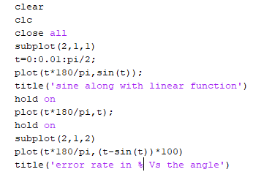
Our linearization
Linearization Graph

Slide 4
Main components
The Body
Brushless motor
ESC
Potentiometers

Slide 5
Data Acquisition and system identification
Arduino Controlling code
Matlab modeling code

Slide 6
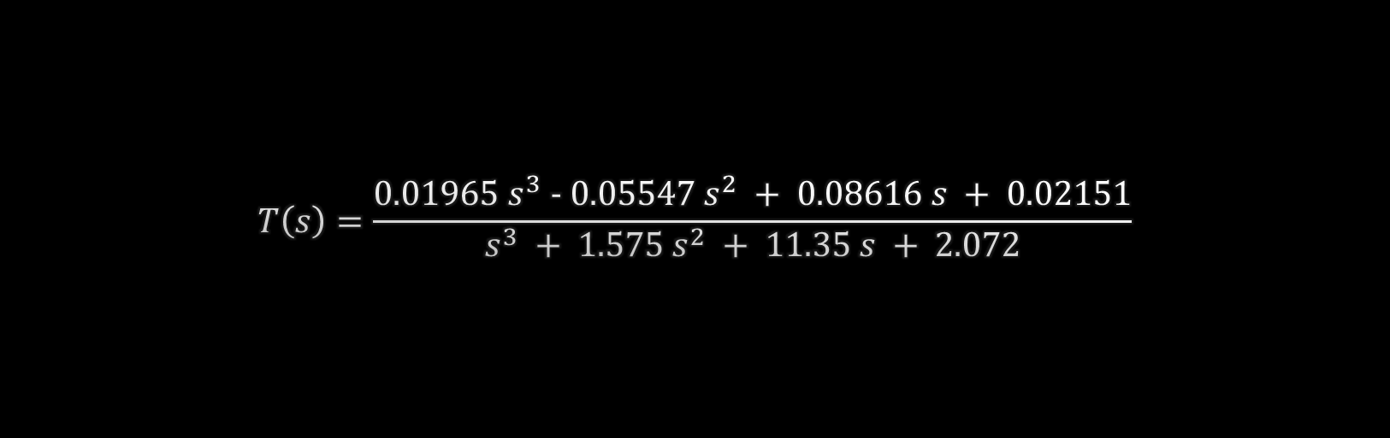
The best model we found
$$T\left(s\right)=\frac{0.01965 s^{3} - 0.05547 s^{2} + 0.08616 s + 0.02151}{s^{3} + 1.575 s^{2} + 11.35 s + 2.072}$$

Slide 7
Why so different ?
The transfer function of the motor is included
Along with other system properties that doesn’t match our approximation

Slide 8
Root locus

Slide 9
Application problem
The high quantization of the system
The constrains over the ESC

Slide 10
Another approach (heuristic)
Digital PID code
PID1
PID 2
PID 3
Response to disturbance (nonstable)
Response to disturbance (stable)

Slide 11
Demo Time !!!!

